Slide 3
DANIEL 1
In the third year of the reign of Jehoiakim king of Judah, Nebuchadnezzar king of Babylon came to Jerusalem and besieged it. 2 And the Lord delivered Jehoiakim king of Judah into his hand, along with some of the articles from the temple of God. These he carried off to the temple of his god in Babylonia and put in the treasure
house of his god.

Slide 4
DANIEL 1
3 Then the king ordered Ashpenaz, chief of his court officials, to bring into the king’s service some of the Israelites from the royal family and the nobility—4 young men without any physical defect, handsome, showing aptitude for every kind of learning, well informed, quick to understand, and qualified to serve in the king’s palace. He was to teach them the language and literature of the Babylonians.

Slide 5
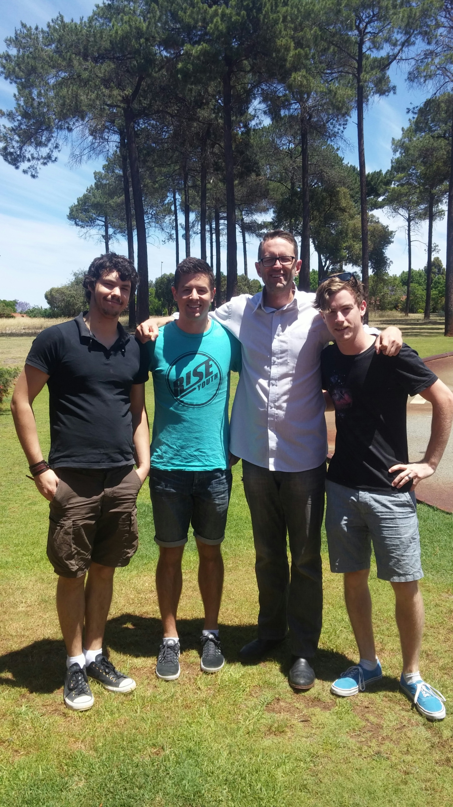

Slide 6
DANIEL 1
5 The king assigned them a daily amount of food and wine from the king’s table. They were to be trained for three years, and after that they were to enter the king’s service.
6 Among those who were chosen were some from Judah: Daniel, Hananiah, Mishael and Azariah. 7 The chief official gave them new names: to Daniel, the name Belteshazzar; to Hananiah, Shadrach; to Mishael, Meshach; and to Azariah, Abednego.

Slide 7
1 PETER
1:1 (MSG) I, Peter, am an apostle on assignment by Jesus, the Messiah, writing to exiles scattered to the four winds.
2:11-12 Friends, this world is not your home, so don’t make yourselves cozy in it. Don’t indulge your ego at the expense of your soul. Live an exemplary life among the natives so that your actions will refute their prejudices. Then they’ll be won over to God’s side and be there to join
in the celebration when he arrives.

Slide 8
DANIEL 1
Daniel 1:8 But Daniel resolved not to defile himself with the royal food and wine, and he asked the chief official for permission not to defile himself this way.
11 Daniel then said to the guard whom the chief official had appointed over Daniel, Hananiah, Mishael and Azariah, 12 “Please test your servants for ten days: Give us nothing but vegetables to eat and water to drink. 13 Then compare our appearance with that of the young men who eat the royal food, and treat your servants in
accordance with what you see.” 14 So he
agreed to this and tested them
for ten days.

Slide 9
DANIEL 1
15 At the end of the ten days they looked healthier and better nourished than any of the young men who ate the royal food. 16 So the guard took away their choice food and the wine they were to drink and gave them vegetables instead.

Slide 10
DANIEL 1
18 At the end of the time set by the king to bring them into his service, the chief official presented them to Nebuchadnezzar. 19 The king talked with them, and he found none equal to Daniel, Hananiah, Mishael and Azariah; so they entered the king’s service. 20 In every matter of wisdom and understanding about which the king questioned them, he found them ten times better than all the magicians and enchanters in
his whole kingdom.

Slide 11
DANIEL 3
1 King Nebuchadnezzar made an image of gold, sixty cubits high and six cubits wide, and set it up on the plain of Dura in the province of Babylon. 2 He then summoned the satraps, prefects, governors, advisers, treasurers, judges, magistrates and all the other provincial officials to come to the dedication of the image he had set up. 3 So the satraps, prefects, governors, advisers, treasurers, judges, magistrates and all the other provincial officials assembled for the dedication of the image that King Nebuchadnezzar
had set up, and they stood before it.

Slide 12
DANIEL 3
4 Then the herald loudly proclaimed, “Nations and peoples of every language, this is what you are commanded to do: 5 As soon as you hear the sound of the horn, flute, zither, lyre, harp, pipe and all kinds of music, you must fall down and worship the image of gold that King Nebuchadnezzar has set up. 6 Whoever does not fall down and worship will immediately be thrown into a blazing furnace.”

Slide 13
DANIEL 3
16 Shadrach, Meshach and Abednego replied to him, “King Nebuchadnezzar, we do not need to defend ourselves before you in this matter. 17 If we are thrown into the blazing furnace, the God we serve is able to deliver us from it, and he will deliver us from Your Majesty’s hand. 18 But even if he does not, we want you to know, Your Majesty, that we will not serve your gods or worship the image of gold you have set up.”

Slide 14
DANIEL 3
24 Then King Nebuchadnezzar leaped to his feet in amazement and asked his advisers, “Weren’t there three men that we tied up and threw into the fire?”
They replied, “Certainly, Your Majesty.”
25 He said, “Look! I see four men walking around in the fire, unbound and unharmed, and the fourth looks like a son of the gods.”

Slide 15
DANIEL 3
26 Nebuchadnezzar then approached the opening of the blazing furnace and shouted, “Shadrach, Meshach and Abednego, servants of the Most High God, come out! Come here!”
So Shadrach, Meshach and Abednego came out of the fire, 27 and the satraps, prefects, governors and royal advisers crowded around them. They saw that the fire had not harmed their bodies, nor was a hair of their heads singed; their robes
were not scorched, and there was no
smell of fire on them.

Slide 16
DANIEL 3
28 Then Nebuchadnezzar said, “Praise be to the God of Shadrach, Meshach and Abednego, who has sent his angel and rescued his servants! They trusted in him and defied the king’s command and were willing to give up their lives rather than serve or worship any god except their own God.

Slide 17
DANIEL 6
1 It pleased Darius to appoint 120 satraps to rule throughout the kingdom, 2 with three administrators over them, one of whom was Daniel. The satraps were made accountable to them so that the king might not suffer loss. 3 Now Daniel so distinguished himself among the administrators and the satraps by his exceptional qualities that the king planned to set him over the whole kingdom.

Slide 18
DANIEL 6
4 At this, the administrators and the satraps tried to find grounds for charges against Daniel in his conduct of government affairs, but they were unable to do so. They could find no corruption in him, because he was trustworthy and neither corrupt nor negligent. 5 Finally these men said, “We will never find any basis for charges against this man Daniel unless it has something to do with the law of his God.”

Slide 19
DANIEL 6
16 So the king gave the order, and they brought Daniel and threw him into the lions’ den. The king said to Daniel, “May your God, whom you serve continually, rescue you!”

Slide 20
DANIEL 6
19 At the first light of dawn, the king got up and hurried to the lions’ den. 20 When he came near the den, he called to Daniel in an anguished voice, “Daniel, servant of the living God, has your God, whom you serve continually, been able to rescue you from the lions?”
21 Daniel answered, “May the king live forever! 22 My God sent his angel, and he shut the mouths of the lions. They have not hurt me, because I was found innocent in his sight. Nor have
I ever done any wrong before you,
Your Majesty.”

Slide 21
DANIEL 6
23 The king was overjoyed and gave orders to lift Daniel out of the den. And when Daniel was lifted from the den, no wound was found on him, because he had trusted in his God.
25 Then King Darius wrote to all the nations and peoples of every language in all the earth:
“May you prosper greatly!

Slide 22
DANIEL 6
26 “I issue a decree that in every part of my kingdom people must fear and reverence the God of Daniel.
“For he is the living God
and he endures forever;
his kingdom will not be destroyed,
his dominion will never end.

Slide 23
DANIEL 6
27 He rescues and he saves;
he performs signs and wonders
in the heavens and on the earth.
He has rescued Daniel
from the power of the lions.”
28 So Daniel prospered during the reign of Darius and the reign of Cyrus the Persian.

Slide 24
SO WHAT?
How does God’s Story intersect Our Story today?
Will you STAND?
When you STAND know that Jesus promises to be with you…
(Matthew 28:20b I am with you always, to the very end of the age.”)

